Slide 1
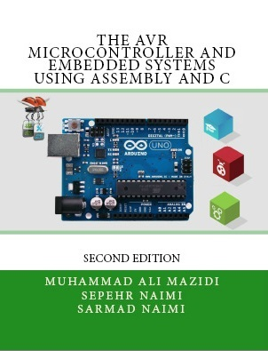

Introduction to Assembly
Chapter 2
Sepehr Naimi
www.NicerLand.com
www.MicroDigitalEd.com

Slide 2
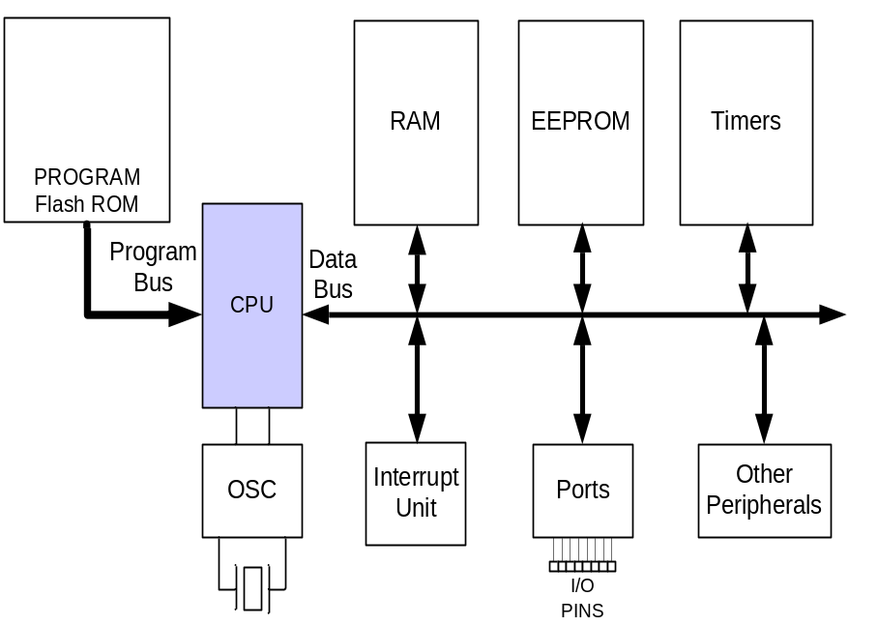
Topics
AVR’s CPU
  Its architecture
  Some simple programs
Data Memory access
Program memory
RISC architecture

Slide 3
AVR’s CPU
AVR’s CPU
  ALU
  32 General Purpose registers (R0 to R31)
  PC register
  Instruction decoder
CPU
ALU
R0
R1
R2
…
SREG:
H
N
Z
I
T
S
V
C
R15
R16
R17
PC
…
Instruction decoder
R30
R31
Instruction Register
registers

Slide 4
Some simple instructions
1. Loading values into the general purpose registers
LDI (Load Immediate)
LDI Rd, k
  Its equivalent in high level languages:
  Rd = k
Example:
  LDI R16,53
    R16 = 53
  LDI R19,$27
  LDI R23,0x27
    R23 = 0x27
  LDI R23,0b11101100
CPU
ALU
R0
R1
R2
…
SREG:
H
N
Z
I
T
S
V
C
R15
R16
R17
PC
…
Instruction decoder
R30
R31
Instruction Register
registers

Slide 5
Some simple instructions
2. Arithmetic calculation
There are some instructions for doing Arithmetic and logic operations; such as:
  ADD, SUB, MUL, AND, etc.
ADD Rd,Rs
  Rd = Rd + Rs
  Example:
  ADD R25, R9
    R25 = R25 + R9
  ADD R17,R30
    R17 = R17 + R30
CPU
ALU
R0
R1
R2
…
SREG:
H
N
Z
I
T
S
V
C
R15
R16
R17
PC
…
Instruction decoder
R30
R31
Instruction Register
registers

Slide 6
A simple program
Write a program that calculates 19 + 95
LDI R16, 19 ;R16 = 19
LDI R20, 95 ;R20 = 95
ADD R16, R20 ;R16 = R16 + R20
CPU
ALU
R0
R1
R2
…
SREG:
H
N
Z
I
T
S
V
C
R15
R16
R17
PC
…
Instruction decoder
R30
R31
Instruction Register
registers

Slide 7
A simple program
Write a program that calculates 19 + 95 + 5
LDI R16, 19 ;R16 = 19
LDI R20, 95 ;R20 = 95
LDI R21, 5 ;R21 = 5
ADD R16, R20 ;R16 = R16 + R20
ADD R16, R21 ;R16 = R16 + R21
LDI R16, 19 ;R16 = 19
LDI R20, 95 ;R20 = 95
ADD R16, R20 ;R16 = R16 + R20
LDI R20, 5 ;R20 = 5
ADD R16, R20 ;R16 = R16 + R20

Slide 8
Some simple instructions
2. Arithmetic calculation
SUB Rd,Rs
  Rd = Rd - Rs
Example:
  SUB R25, R9
    R25 = R25 - R9
  SUB R17,R30
    R17 = R17 - R30
CPU
ALU
R0
R1
R2
…
SREG:
H
N
Z
I
T
S
V
C
R15
R16
R17
PC
…
Instruction decoder
R30
R31
Instruction Register
registers

Slide 9
Some simple instructions
2. Arithmetic calculation
INC Rd
  Rd = Rd + 1
Example:
  INC R25
    R25 = R25 + 1
DEC Rd
  Rd = Rd - 1
Example:
  DEC R23
    R23 = R23 - 1
CPU
ALU
R0
R1
R2
…
SREG:
H
N
Z
I
T
S
V
C
R15
R16
R17
PC
…
Instruction decoder
R30
R31
Instruction Register
registers

Slide 10
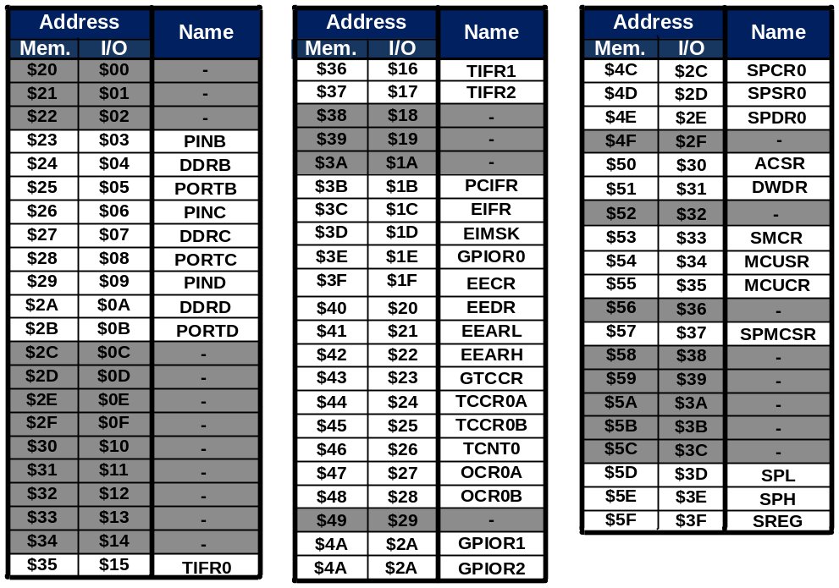
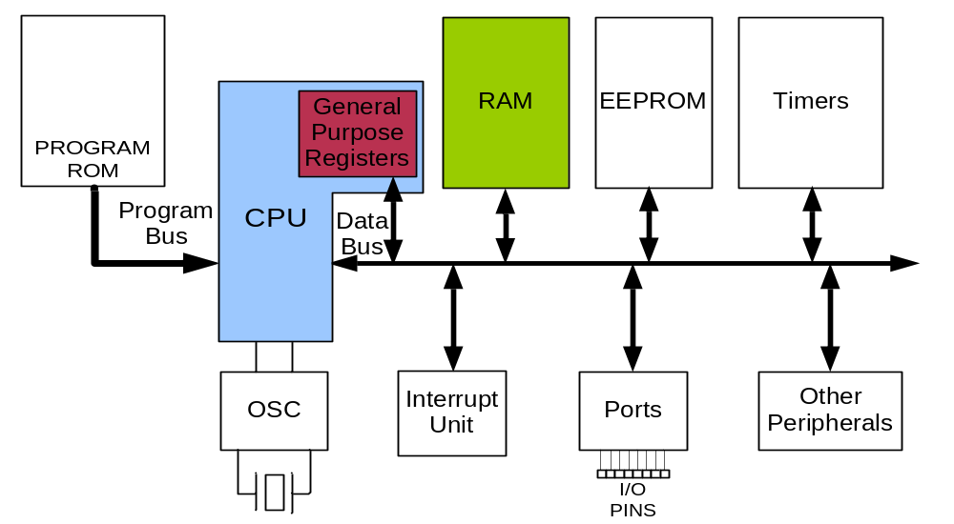
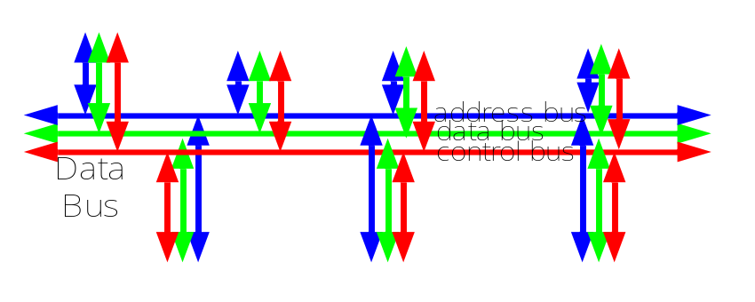
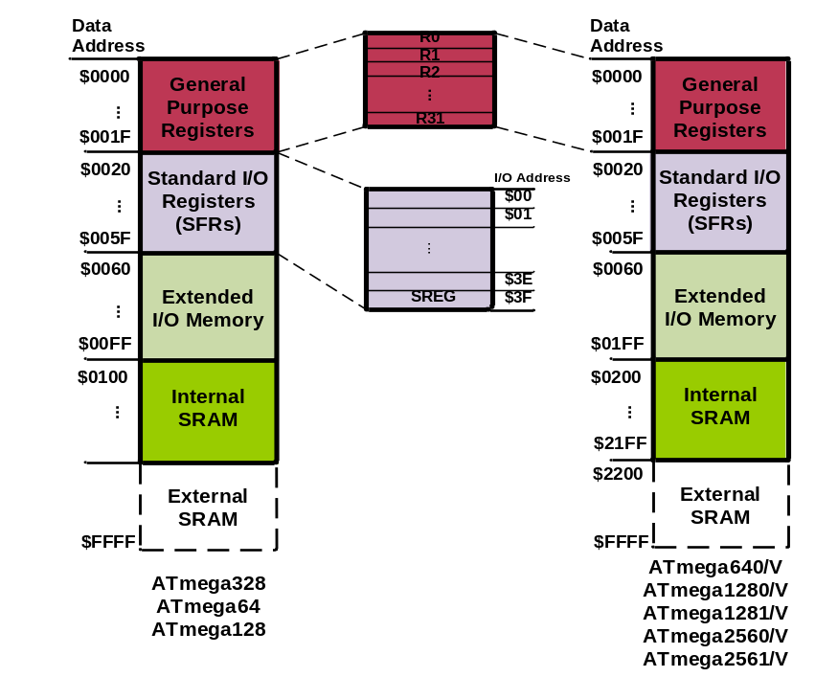
Data Address Space
Example: Add contents of location 0x90 to contents of location 0x95 and store the result in location 0x313.
Example: Store 0x53 into the SPH register. The address of SPH is 0x5E
Example: What does the following instruction do?
LDS R20,2
LDS (Load direct from data space)
STS (Store direct to data space)
Example: Write a program that stores 55 into location 0x80 of RAM.
Example: Write a program that copies the contents of location 0x80 of RAM into location 0x81.
Solution:
LDS R20, 0x90 ;R20 = [0x90]
LDS R21, 0x95 ;R21 = [0x95]
ADD R20, R21 ;R20 = R20 + R21
STS 0x313, R20 ;[0x313] = R20
LDS Rd, addr ;Rd = [addr]
STS addr,Rd ;[addr]=Rd
Solution:
LDI R20, 0x53 ;R20 = 0x53
STS 0x5E, R20 ;SPH = R20
Solution:
LDI R20, 55 ;R20 = 55
STS 0x80, R20 ;[0x80] = R20 = 55
Answer:
It copies the contents of R2 into R20; as 2 is the address of R2.
Example:
LDS R1, 0x60
Example:
STS 0x60,R15 ; [0x60] = R15
Solution:
LDS R20, 0x80 ;R20 = [0x80]
STS 0x81, R20 ;[0x81] = R20 = [0x80]

Slide 11
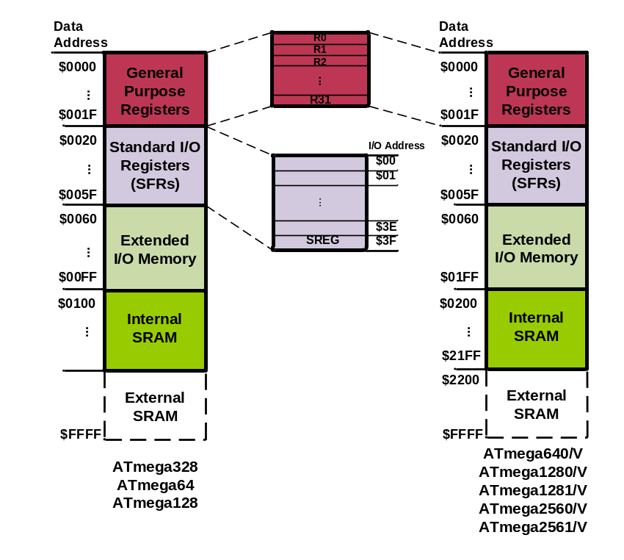
Data Address Space
Example: Write a program that adds the contents of the PINC I/O register to the contents of PIND and stores the result in location 0x90 of the SRAM
IN (IN from IO location)
Using Names of I/O registers
OUT (OUT to I/O location)
IN Rd,IOaddress ;Rd = [addr]
Solution:
IN R20,PINC ;R20 = PINC
IN R21,PIND ;R21 = PIND
ADD R20,R21 ;R20 = R20 + R21
STS 0x90,R20 ;[0x90] = R20
Example:
OUT SPH,R12 ;OUT 0x3E,R12
IN R15,SREG ;IN R15,0x3F
OUT IOAddr,Rd ;[addr]=Rd
Example:
IN R1, 0x3F ;R1 = SREG
IN R17,0x3E ;R17 = SPH
Example:
OUT 0x3F,R12 ;SREG = R12
OUT 0x3E,R15 ;SPH = R15

Slide 12
Machine Language
ADD R0,R1
LDI R16, 2
LDI R17, 3
ADD R16, R17
000011 00 0000 0001
opcode
operand
1110 0000 0000 0010
1110 0000 0001 0011
0000 1111 0000 0001

Slide 13
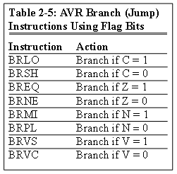
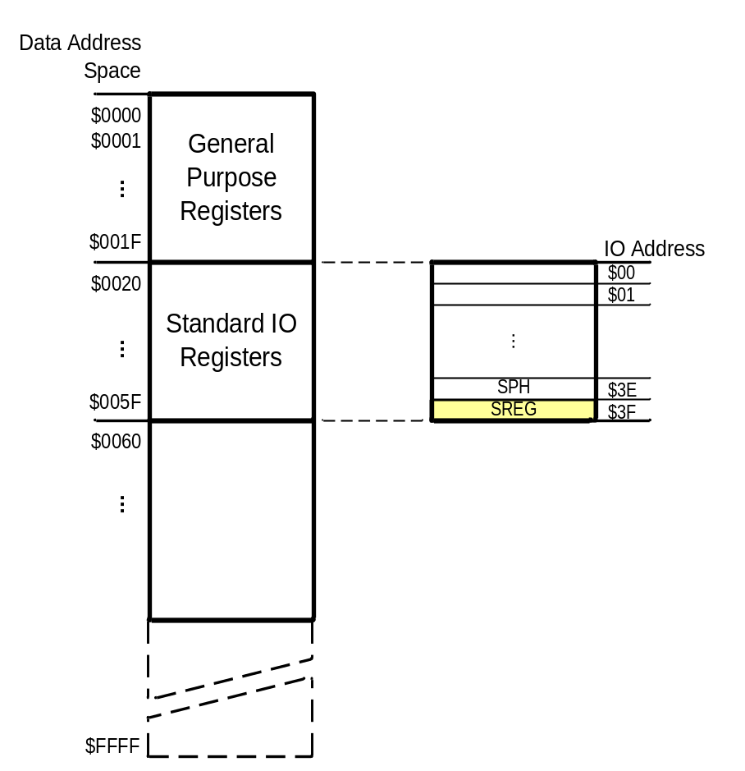
Status Register (SREG)
SREG:
I
T
H
S
V
N
Z
C
Interrupt
Carry
oVerflow
Zero
Temporary
Sign
N+V
Negative
Half carry
Example: Show the status of the C, H, and Z flags after the subtraction of 0x9C from 0x9C in the following instructions:
LDI R20, 0x9C
LDI R21, 0x9C
SUB R20, R21 ;subtract R21 from R20
Example: Show the status of the C, H, and Z flags after the subtraction of 0x23 from 0xA5 in the following instructions:
LDI R20, 0xA5
LDI R21, 0x23
SUB R20, R21 ;subtract R21 from R20
Example: Show the status of the C, H, and Z flags after the subtraction of 0x73 from 0x52 in the following instructions:
LDI R20, 0x52
LDI R21, 0x73
SUB R20, R21 ;subtract R21 from R20
Example: Show the status of the C, H, and Z flags after the addition of 0x9C and 0x64 in the following instructions:
LDI R20, 0x9C
LDI R21, 0x64
ADD R20, R21 ;add R21 to R20
Example: Show the status of the C, H, and Z flags after the addition of 0x38 and 0x2F in the following instructions:
LDI R16, 0x38 ;R16 = 0x38
LDI R17, 0x2F ;R17 = 0x2F
ADD R16, R17 ;add R17 to R16
CPU
ALU
R0
R1
R2
…
SREG:
Solution:
$52 0101 0010
- $73 0111 0011
$DF 1101 1111 R20 = $DF
C = 1 because R21 is bigger than R20 and there is a borrow from D8 bit.
Z = 0 because the R20 has a value other than zero after the subtraction.
H = 1 because there is a borrow from D4 to D3.
I
T
H
S
V
N
Z
C
Solution:
$9C 1001 1100
- $9C 1001 1100
$00 0000 0000 R20 = $00
C = 0 because R21 is not bigger than R20 and there is no borrow from D8 bit.
Z = 1 because the R20 is zero after the subtraction.
H = 0 because there is no borrow from D4 to D3.
Solution:
$A5 1010 0101
- $23 0010 0011
$82 1000 0010 R20 = $82
C = 0 because R21 is not bigger than R20 and there is no borrow from D8 bit.
Z = 0 because the R20 has a value other than 0 after the subtraction.
H = 0 because there is no borrow from D4 to D3.
Solution: 1
$9C 1001 1100
+ $64 0110 0100
$100 1 0000 0000 R20 = 00
C = 1 because there is a carry beyond the D7 bit.
H = 1 because there is a carry from the D3 to the D4 bit.
Z = 1 because the R20 (the result) has a value 0 in it after the addition.
Solution: 1
$38 0011 1000
+ $2F 0010 1111
$67 0110 0111 R16 = 0x67
C = 0 because there is no carry beyond the D7 bit.
H = 1 because there is a carry from the D3 to the D4 bit.
Z = 0 because the R16 (the result) has a value other than 0 after the addition.
R15
R16
R17
PC
…
Instruction decoder
R30
R31
Instruction Register
registers

Slide 14
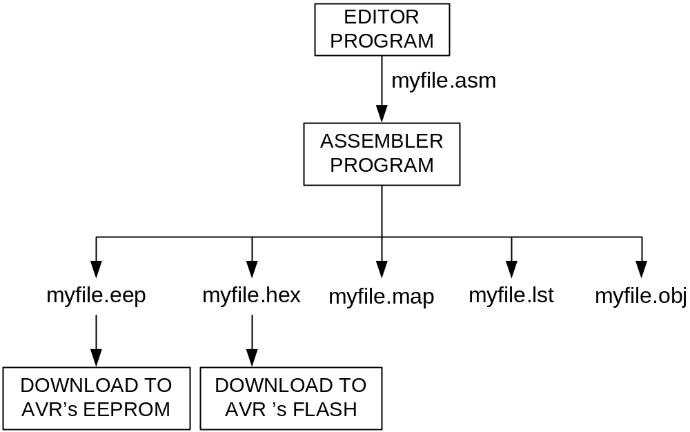
Assembler
Assembly
assembler
Machine
Language

Slide 15
Assembler Directives
.EQU and .SET
.EQU name = value
  Example:
.EQU COUNT = 0x25
  LDI R21, COUNT ;R21 = 0x25
  LDI R22, COUNT + 3 ;R22 = 0x28
.SET name = value
  Example:
  .SET COUNT = 0x25
  LDI R21, COUNT ;R21 = 0x25
  LDI R22, COUNT + 3 ;R22 = 0x28
  .SET COUNT = 0x19
  LDI R21, COUNT ;R21 = 0x19

Slide 16
Assembler Directives
.ORG
.ORG address
00 E205
01 0000
02 0000
03 0000
04 0000
05 0000
06 0000
07 E314
08 E321
09 0000
0A 0000
Program.asm
.ORG 0
LDI R16, 0x25
.ORG 0x7
LDI R17, 0x34
LDI R18, 0x31
assembler

Slide 17
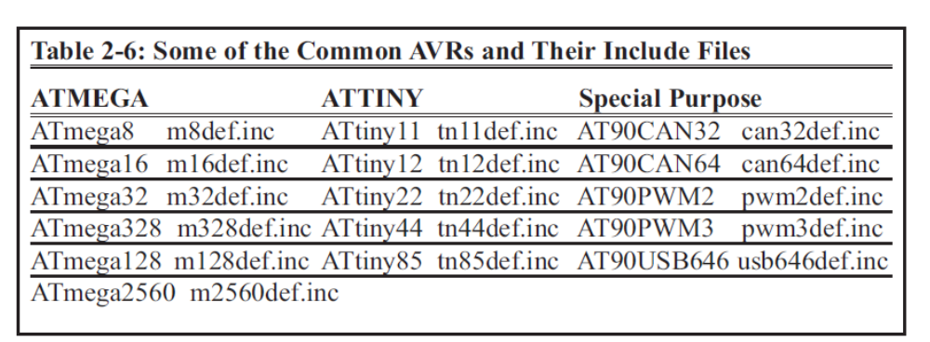
Assembler Directives
.INCLUDE
.INCLUDE “filename.ext”
M328def.inc
.equ SREG = 0x3f
.equ SPL = 0x3d
.equ SPH = 0x3e
....
Program.asm
LDI R20, 10
OUT SPL, R20

Slide 18
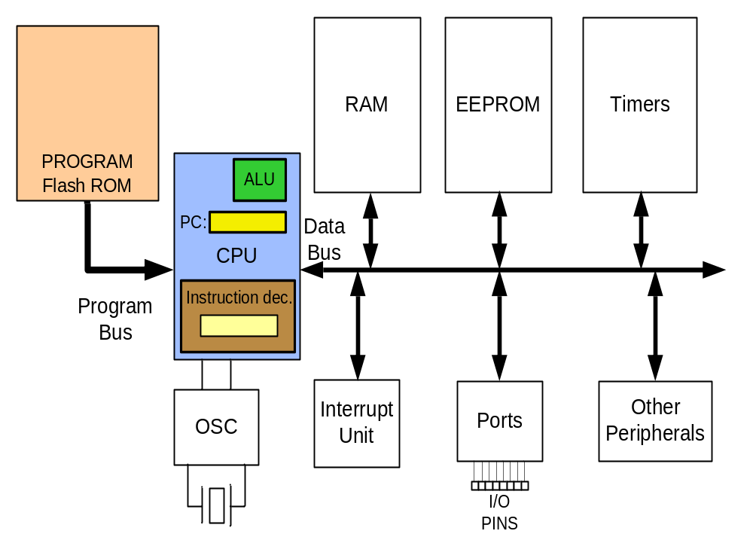
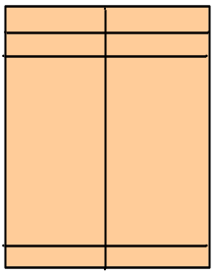
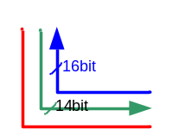
Flash memory and PC register
LDI R16, 0x25
LDI R17, $34
LDI R18, 0x31
ADD R16, R17
ADD R16, R18
LDI R17, 11
ADD R16, R17
STS SUM, R16
HERE:JMP HERE
00 E205
01 E314
02 E321
03 0F01
04 0F02
05 E01B
06 0F01
07 9300
08 0300
09 940C
0A 0009
E205
E314
E321
0F01
0F02
16-bit
E01B
0F01
9300
0300
940C
0009
3
0
9
1
5
2
7
A
4
8
B
6

Slide 19
Fetch and execute
Old Architectures
00 E205
01 E314
02 E321
03 0F01
04 0F02
05 E01B
06 0F01
07 9300
08 0300
09 940C
0A 0009
Instruct 4
Instruct 3
Instruct 2
Instruct 1
16-bit
Fetch
Execute

Slide 20
Pipelining
Pipelining
00 E205
01 E314
02 E321
03 0F01
04 0F02
05 E01B
06 0F01
07 9300
08 0300
09 940C
0A 0009
Instruct 4
Instruct 3
Instruct 2
16-bit
Instruct 1
Fetch
Execute

Slide 21
How to speed up the CPU
Increase the clock frequency
  More frequency ➔ More power consumption & more heat
  Limitations
Change the architecture
  Pipelining
  RISC

Slide 22
Changing the architecture
RISC vs. CISC
CISC (Complex Instruction Set Computer)
  Put as many instruction as you can into the CPU
RISC (Reduced Instruction Set Computer)
  Reduce the number of instructions, and use your facilities in a more proper way.

Slide 23
RISC architecture
Feature 1
  RISC processors have a fixed instruction size. It makes the task of instruction decoder easier.
    In AVR the instructions are 2 or 4 bytes.
  In CISC processors instructions have different lengths
    E.g. in 8051
      CLR C ; a 1-byte instruction
      ADD A, #20H ; a 2-byte instruction
      LJMP HERE ; a 3-byte instruction

Slide 24
RISC architecture
Feature 2: reduce the number of instructions
  Pros: Reduces the number of used transistors
  Cons:
    Can make the assembly programming more difficult
    Can lead to using more memory

Slide 25
RISC architecture
Feature 3: limit the addressing mode
  Advantage
    hardwiring
  Disadvantage
    Can make the assembly programming more difficult

Slide 26
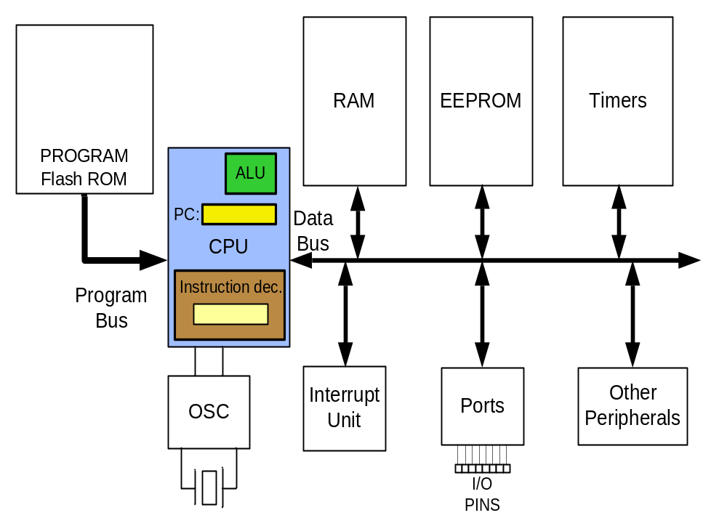
RISC architecture
Feature 4: Load/Store
  LDS R20, 0x200
  LDS R21, 0x220
  ADD R20, R21
  STS 0x230, R20

Slide 27
RISC architecture
Feature 5 (Harvard architecture): separate buses for opcodes and operands
  Advantage: opcodes and operands can go in and out of the CPU together.
  Disadvantage: leads to more cost in general purpose computers.
LDS R20, 0x100 ; R20 = [0x100]
ADD R20,R21 ; R20 = R20 + R21
ADD R20, R21
LDS R20, 0x100
Fetch
Execute
CPU
Code
Memory
Control bus
Control bus
Data
Memory
Data bus
Data bus
Address bus
Address bus

Slide 28
RISC architecture
Feature 6: more than 95% of instructions are executed in 1 machine cycle

Slide 29
RISC architecture
Feature 7
  RISC processors have at least 32 registers. Decreases the need for stack and memory usages.
    In AVR there are 32 general purpose registers (R0 to R31)

